Slide 1
Azure Media Services: Building your own YouTube, sort of
Isaac Levin (Isaac.Levin@microsoft.com)
Application Development Manager
@isaac2004

Slide 2

http://aka.ms/levin-ams

Slide 3
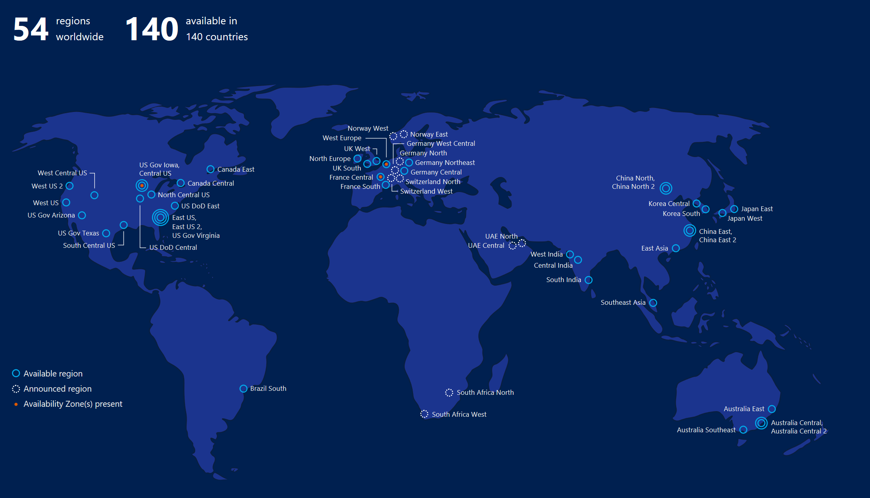
















































Azure Platform Services
Security & Management
Compute
Web and Mobile
Developer Services
Hybrid
Operations
Cloud
Services
Service
Fabric
Web Apps
Functions
API
Management
Visual Studio
Azure SDK
Portal
Azure AD
Connect Health
Batch
Remote App
Mobile
Apps
Logic
Apps
Notification
Hubs
Team Project
Application
Insights
Active
Directory
AD Privileged
Identity
Management
Multi-Factor
Authentication
Analytics & IoT
Media & CDN
Data
Backup
Automation
HDInsight
Machine
Learning
VoD/Live
Transcoding
Video AI
SQL
Database
SQL Data
Warehouse
Operational
Insights
Key Vault
Data
Factory
Event
Hubs
Multi DRM
VoD/Live Channel
Streaming
Redis
Cache
Search
Import/Export
Store /
Marketplace
Site
Recovery
Stream
Analytics
Mobile
Engagement
Azure Media
Player
Content Delivery
Network (CDN)
DocumentDB
Tables
VM Image Gallery
& VM Depot
StorSimple
Infrastructure Services
Compute
Storage
Networking
Virtual Machines
Containers
BLOB Storage
Azure Files
Premium Storage
Virtual Network
Load Balancer
DNS
Express
Route
Traffic Manager
VPN Gateway
Application Gateway
Datacenter Infrastructure

Slide 4

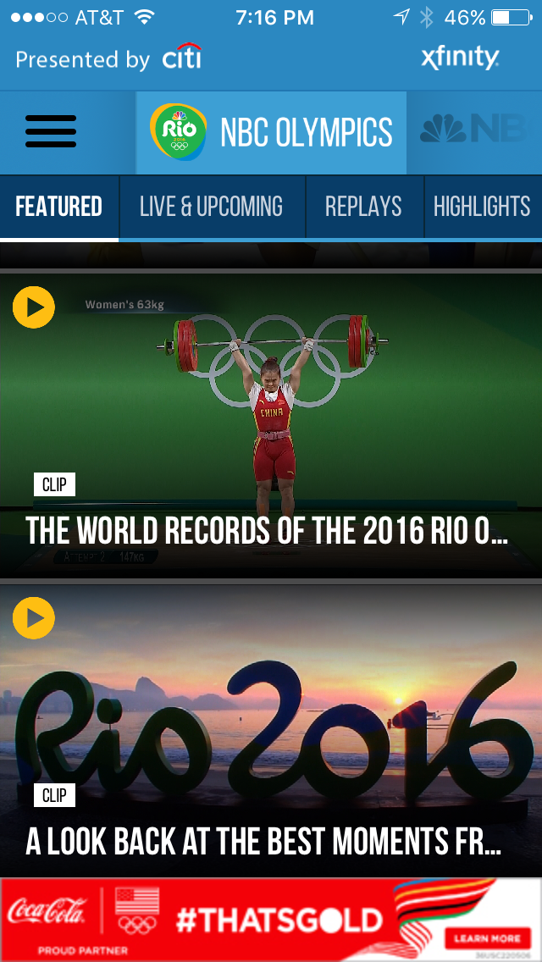
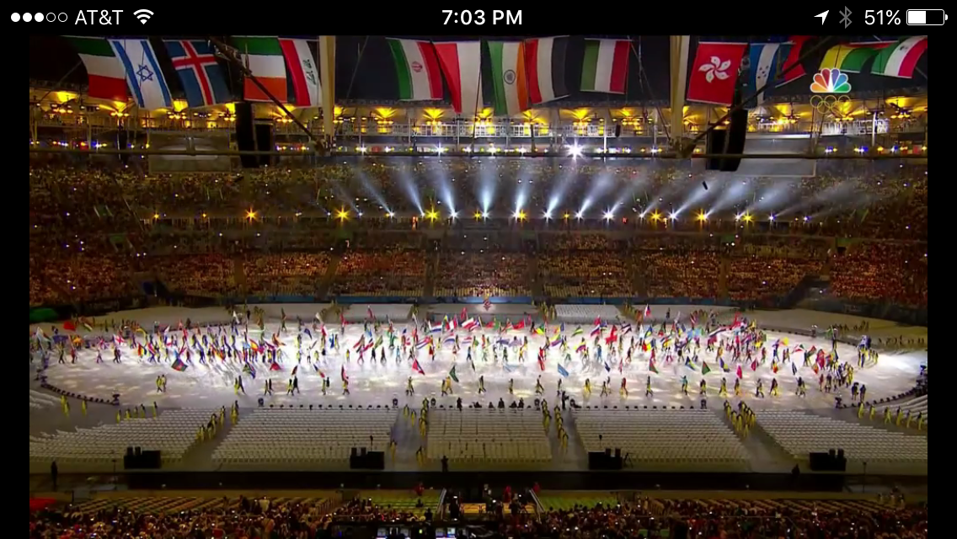
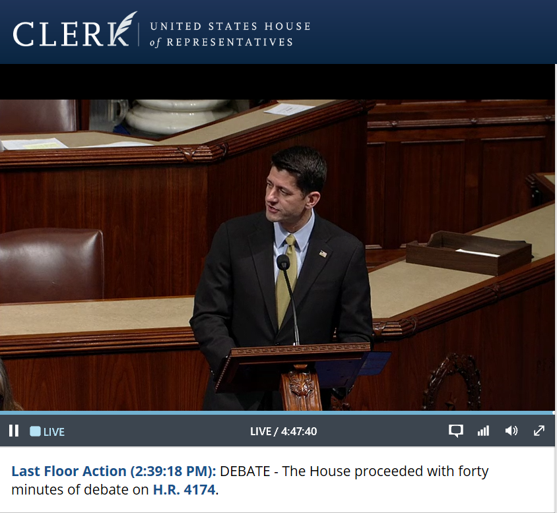
Cloud Media Scenarios
Video Streaming
Enterprise / Collaborative
Storage/Web Distribution
Video On-Demand Portals
Sports, Entertainment, News
Education
Health Care
Live Broadcast & Events
Linear TV + Advertising
Sports Content
News Channels
Music Concerts
Awards Ceremonies
Town Halls / Conferences
Digital Marketing / Advertising
Retail
Finance / Banking
Brand Awareness
Sales Support
Corporate + Internal
Training
Product Marketing
Employee Sharing
Executive
Industry
Education / Public Sector
Remote Learning
Lectures
Research / Video Libraries
Government Agencies
Archive/Backup
Websites
Mobile Apps
Advertising
Software updates
Embedded Firmware
Software
Gaming
Notes:
So what can your customers actually do with media services? Here’s a list of options to spark the conversation

Slide 5

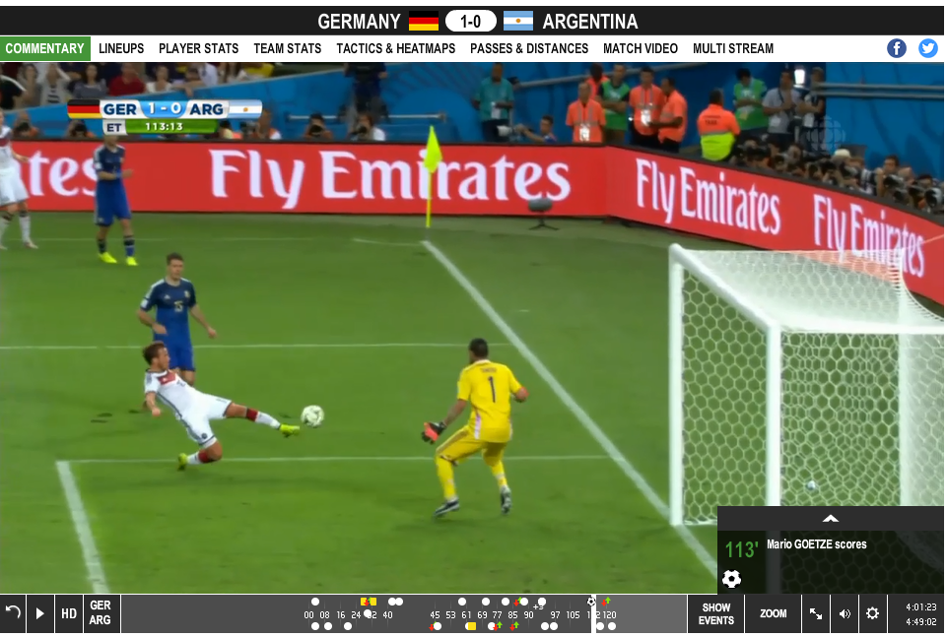
FIFA World Cup 2014 powered by Azure Media Services
30 days of events/64 matches
Partnered with Deltatre for content acquisition and immersive players
10 broadcasters, 3 continents
Image Cruz, Cristian (2014) [Electronic] [World Wide Web from http://www.flickr.com/photos/crystiancruz/14238506068]

Slide 6





Azure Media Services
Azure Media Services is an extensible, multi-tenant platform that enables end-to-end video workflows in the Azure public cloud and relies on Azure Storage, Azure Compute, Azure Networking, and other Azure Cloud Infrastructure Services.
.
Cloud Upload & Storage
Encoding
&
Clipping
Content Protection
Live & On Demand Streaming
with Azure CDN
Player
Clients

Slide 7
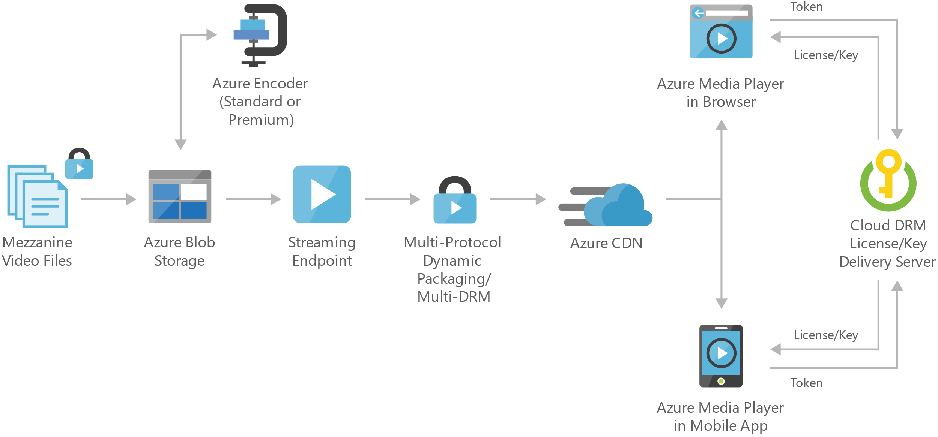
Video on Demand
Key Features in AMS
Upload Video Files to Azure Blob Storage
2 choices of Cloud Encoding supporting many video/audio formats – Standard & Premium
Streaming includes Dynamic Packaging & Dynamic Encryption
Output formats: Smooth, HLS v3, HLS v4, MPEG-DASH, CMAF, cbsc
Play Ready DRM, Apple Fairplay, Google Widevine, AES128 clear-key encryption
Offline Support
DRM License Key Management available from Cloud
Integrated to Azure CDN

Slide 8
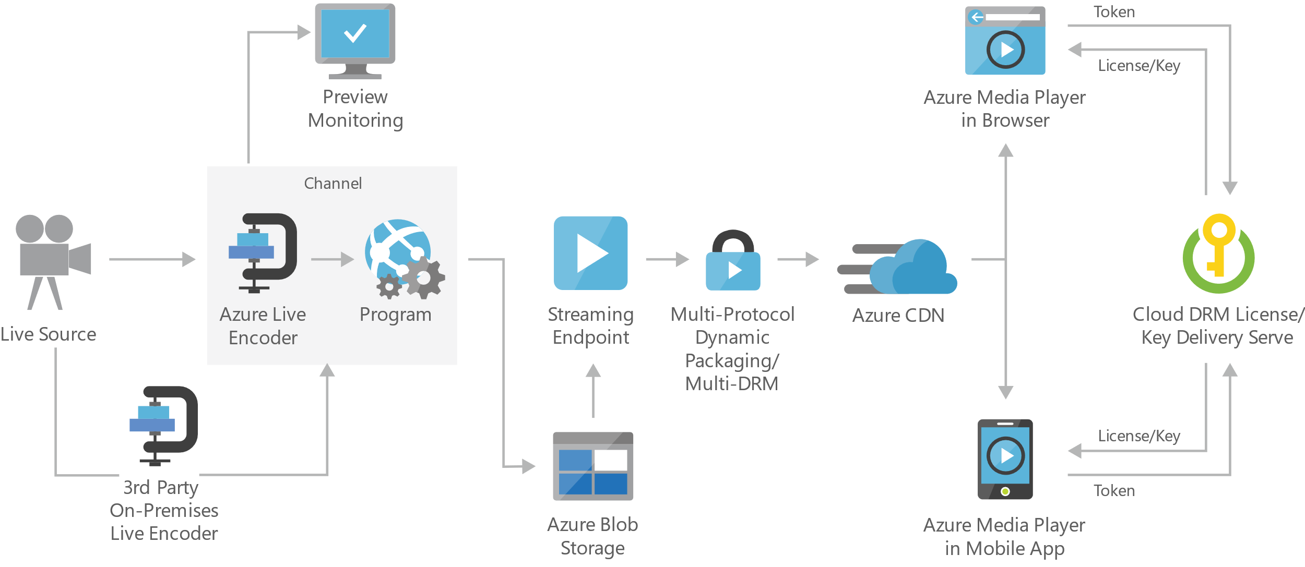
Live Streaming
Add’l Features in AMS
Real-time Ingest (RTMP, fmp4)
Live Cloud Encoding (up to 1080p30) with SCTE-35 Ad Markers
Cloud DVR, Instant Live-to-VOD, and Virtual Sub-clipping / Dynamic Filtering
Automated archival to storage for VOD Playback
RTMP relay support for YouTube, Facebook publishing

Slide 9

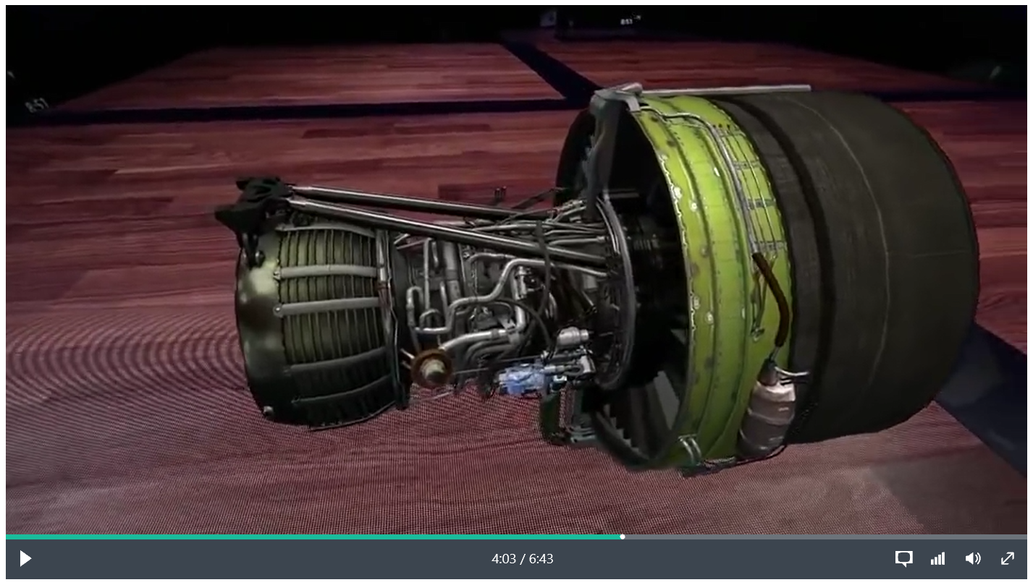
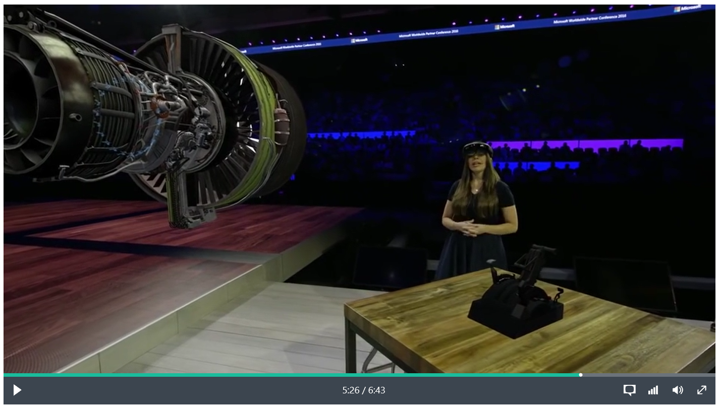







Azure Media Player
A Single player for all screens any device or browser
HTML5 / JavaScript / CSS development
Auto-detect OS and playback of best format
Customize, Develop & Add Plug-ins, and embed it in your own web or mobile sites
AMP Plug-ins at http://amp.azure.net/libs/amp/latest/docs/PLUGINS.html
Try it @ http://aka.ms/ampdemo

Slide 10
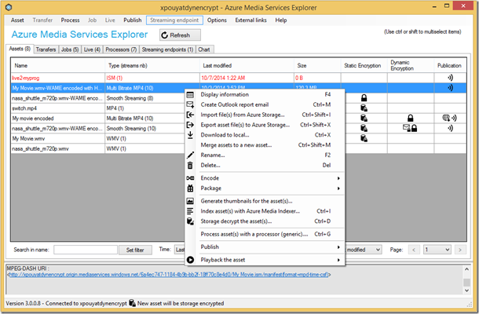
Don’t Want to Code?
Try the Azure Media Services Explorer Tool
A No-Code Easy UI way to use Azure Media Services.
Download for free at: http://aka.ms/amse

Slide 11
Developing Against AMS
Concepts to Consider
Assets
Digital File (Video, Audio, Image, Text Tracks, Caption Files)
Mapped to Blob Container in Azure Storage
Input & Output Assets (Before & After Processing)
Transforms
Simple Workflow of Tasks for file processing
Recipe for Job
Jobs
Implement the Recipe
Specify Input / Output
Streaming Endpoints
Delivers content directly to client player application or CDN

Slide 12
Coding with AMS Demo

Slide 13

Video Artificial Intelligence
Video AI

Slide 14

Imagine if you could…
Automatically create all of the metadata (spoken text, written text, faces, places, objects etc) for any video, including from their archives – flag any adult or objectionable content
Relate advertisements dynamically to the content of the program for increased viewer relevance, value, and response
Collaboratively upload & edit videos in real-time and through the Cloud to speed up time to air for new stories
Enable viewers to take advantage of deep search capabilities – search by Name, Search by Keyword, Search by Topic
Distribute playable clips of live video content internally or externally without long download or encode times
Understand which part of your broadcasts were most popular/interesting to viewer and then add Interactive Elements into the viewing experience
Create automated summaries or highlight reels of video content based on scene detection, specific people, and motion/actions within the video

Slide 15

Video AI is the key to solving these challenges….
Improve Content Discoverability
Increase Content Value
Personalize the Viewing Experience
Uncover Hidden Content Insights
Reduce Manual Labor
Auto Transcripts
Find Footage Quickly
Automatically Create Highlight Reels

Slide 16



Microsoft Cognitive Services
Give your apps a human side
Vision
From faces to feelings, allow your apps to understand images and video
Speech
Hear and speak to your users by filtering noise, identifying speakers, and understanding intent
Language
Process text and learn how to recognize what users want
Knowledge
Tap into rich knowledge amassed from the web, academia, or your own data
Search
Access billions of web pages, images, videos, and news with the power of Bing APIs
Labs
An early look at emerging Cognitive Services technologies: discover, try & give feedback on new technologies before general availability

Slide 17
Video AI Services
Azure Media Analytics | AI Features
Speech-to-Text
Convert audio to text based on acoustic language models
Face detection
Find when each face appears in the video
Video stabilization
Create smooth videos from videos captured by moving camera
Video OCR
Extract text that appears in videos as overlay, slides or background
Face/Image redaction
Detect faces and choose which ones you want to redact
Motion detection
Detect when motion has occurred in videos
Face emotion detection
Recognize the emotion of a person or crowd based on facial expressions
Video summarization
Create summaries of long videos to enable quick previews
Content moderation
Detect and prevent explicitly visual or objectionable content
Object detection
Detect objects based on a pre-defined object model
Available as individual Media Processors via APIs

Slide 18





















Video Indexer | Bundling 20 AI Features Together
Linguistic Transcript
Convert speech to text for 10 languages
Noise canceling
Eliminate background noise for call recordings using Skype filters
Face detection
Find when does each face appears in the video
Keywords Extraction
Find out the keywords discussed in each segment
Contextual Search
Understand the context of search results
Spoken Language ID
Detect spoken language to support multi language content
Call recording enhancement
Optimized ingestion for calls
Face grouping
Identify multiple appearances of the same person
Sentiment Analysis
Compare levels of positive vs negative spoken or written moments over the timeline
In-place Editing
Make manual fixes for errors detected
Custom Vocabulary
Fit to Industry, market and domain specific terms
Annotations
Tag objects such as cat, table, car, ball etc when they appear
Identification
See name, job and biography of celebrities and ordinary people
Content Moderation
Detect explicit visuals or text in audio or overlay
Sub-Clipping
Source video is stored once for multiple playlists of video segments
</>
Speaker Diarization
Map and understand who spoke when
OCR
Extract text that appears in video as overlay, slides or background
Shot Detection
Detect when a shot starts/ends based on visual analysis
Recommendations
Find more videos with similar people discussing similar topics
Programmatic APIs
Index / Search API and UI widgets enable embedding in other website/apps
Translation
Translate source to 54 languages – text or voice
Brand detection
Track brand mentions in speech or on screen overheads
Emotion sensing*
Detect emotions expressed in speech, vocal signals and facial expressions
Logos*
Identify visual logos that appear on screen
Live Analytics*
Analyze content coming from a live broadcast source
* Coming Soon

Slide 19
Video Indexer Demo Try it yourself at http://vi.microsoft.com

Slide 20
Video Indexer | Typical workflow
Video AI | Products
Video Indexer
Extract
Extract a set of pre-defined cognitive metadata
Curate
Review and curate the metadata using a web portal
Publish
Embed player and insights widgets in your own apps
Customer app

Slide 21
Video Indexer | Technologies under the hood
Azure Core Services
Azure Websites, Azure docDB, Azure Search, Azure API Management
Azure Media Services
Media encoder, CDN, Video Encryption, Media Player
Media Analytics (Indexer, Indexer 2, OCR, Content Moderation, Redactor, Annotator)
Microsoft Cognitive Services
Computer vision, face grouping, head pose, Bing speech, speaker diarization, Language understanding, linguistic analysis, text analytics, Bing image search and celebrity identification, Bing entity search, Human Moderation Review , Entity extraction
Languages support
Transcription supported languages 10: English, Russian, Japanese, German, Spanish, French, Brazilian Portuguese, Italian, Chinese Simplified and Arabic
Translation support for 54 languages

Slide 22
Additional resources
Video Indexer – http://www.videoindexer.ai
Media Explorer Tool – http://aka.ms/amse
Microsoft & Media – http://microsoft.com/media
Azure Media Services – http://azure.com/media
AMS Demo Repo - https://aka.ms/levin-amsdemo
Notes:
Use this slide to share additional content available that attendees should know about. In this section you can call out whitepapers or websites that you and your team have created.

Slide 23
Thank You!
Isaac Levin (Isaac.Levin@microsoft.com)

